Slide 1



SEEDLINK
“Seed Meets Technology”

Slide 2
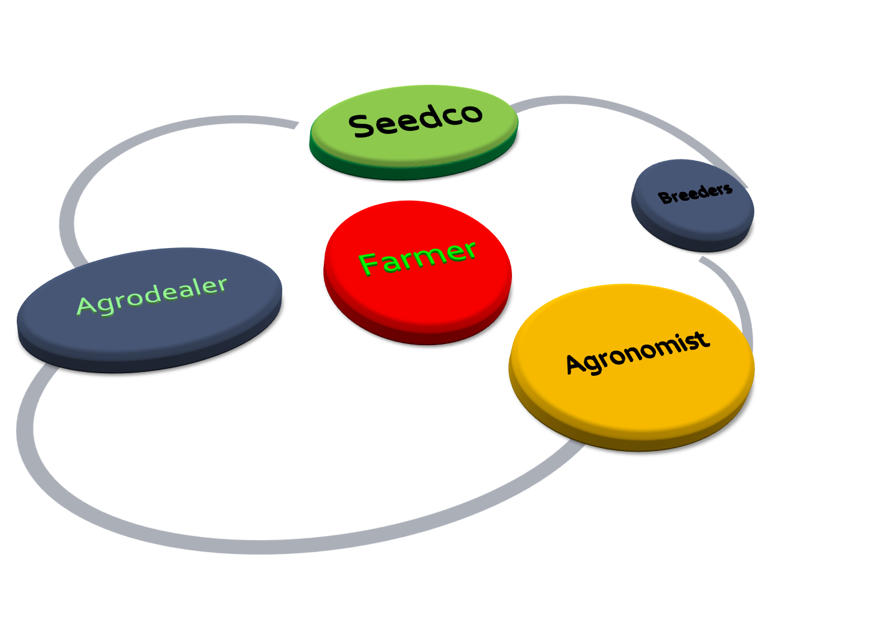
The Ecosystem

Slide 3

Pain Points
Farmer | Agrodealer (Seed Stockists) | Seedco
Communication Inefficiencies | Stock projection problem. No seed demand data. | Communication Inefficiencies No Seed demand data
Lack of input (Seed) authentication infrastructure | Communication Inefficiencies | No geo-spatial commercial intelligence Geo-localized seed-demand data. No geo-targeted interventions.
Lack of crop microinsurance or rebate guarantee. |  | Losses from Input Counterfeits
Agronomic gaps Transactional agro-dealer relationship

Slide 4

The SeedLink Technology
Innovation | Deployment | Users | Customers
Mobile (Cloud –Based) Scalable/ Replicable | SMS Mobile App | Farmers Seedcos Agrodealers Field Agronomists | Farmers (Agronomic SMs) Seedcos Breeders Advertisers
Geo-spatial seed demand mapping
Execution | Primary Players | Deployment | Parameters
POS seed purchase registration | Agrodealers Farmers | SMS Composite coding system: Location Geocoding Seed variety Coding | Farmer Location Seed variety Quantity

Slide 5
Measurable Variables
      Seed Purchase habits and patterns.
      Agrodealer commercial performance.
      Inventory control and demand projections.
      Aggregated farmer seed orders and Agrodealer placement

Slide 6
The Competitive Landscape
Innovation | Deployment | Thematic Areas | Gaps
I-Shamba | SMS Voice | Agronomic tips Market Price | No seed supply chain solution
E-Soko | IVR SMS | Agronomic tips Market Price | No seed supply chain solution
iProcure |  | Last mile delivery Order aggregation | No seed supply chain solution
SeedLink | SMS | Commercial intelligence Automated crop calendar alerts Best practice SMS Weather Alerts | A full-stack seed supply chain solution.

Slide 7
Deployment Infrastructure:
Alphanumerical (geo-localized, agro-ecological) product serialization-
MAUGMOS00120018.
MA
UG
MOS
0012
0018
CROP/
VARIETY
(MAIZE)
COUNTY
SUB-COUNTY
QUANTITY
LOCATION
(GEO)

Slide 8
Business Model
Revenue Model |  | Revenue Streams
Agrodealer Incentivization Product-discounting Product-marketing |  | SaaS (Licensing) fees
Farmer value-addition |  | SMS subscription revenues
Derived Revenues |  | Microinsurance premium splits
 |  | Bank Commissions
Affiliate Advertising |  | SMS advertising- Agro companies

Slide 9
Marketing Strategy
Existing demo plots by Seedcos.
Farmer P2P referrals-For product-discounting.
Link Farmers to mapped-out nearby Agro-vets.

Slide 10


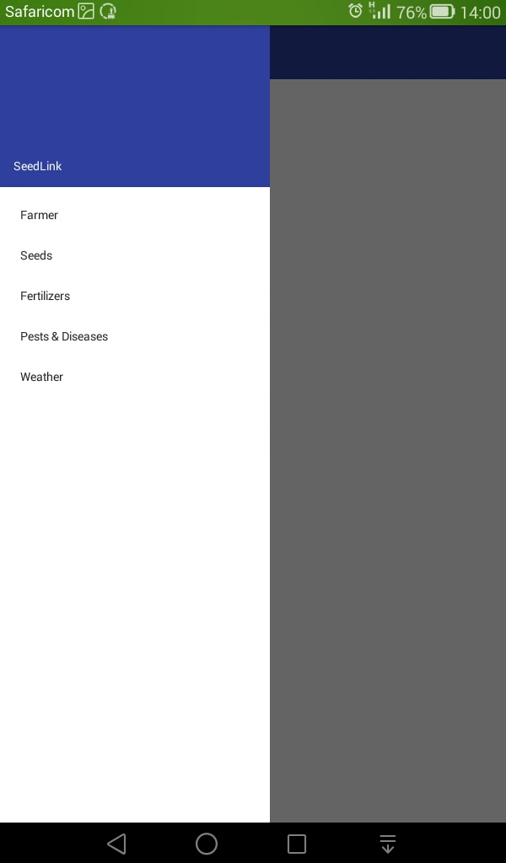
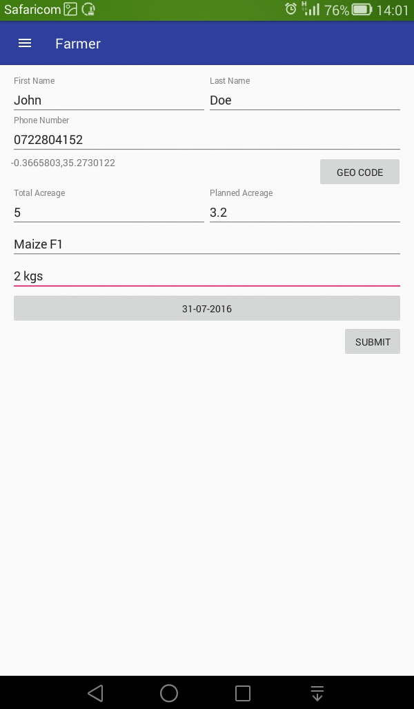
PRODUCT DEMO

Slide 11
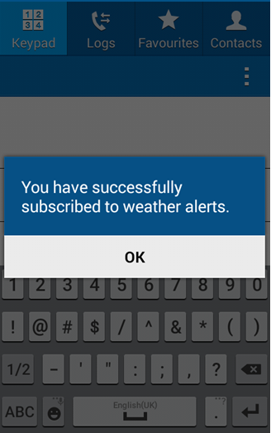
PRODUCT DEMO

Slide 12
THANK YOU
The Team:
Joel Amuyunzu Odemu (M&E)
Mariachana Moturi (Systems Analyst)
Regina Gitau (Seed Quality Assurance)
Derick Mureithi (Software Developer)
Tony Iha Kazungu (MIS Advisor)
Kiprutto Bett (Software Developer)
Anthony Ochieng(Project Manager)

